Slide 1
SC1015 Mini-Project
Diabetes Prediction System
Z139, Group 10
Nanditha Kumar (U2221998B)
Kalidoss Madhumitha (U2222332A)
Praveena Vijayan (U2222549G)

Slide 2
Table of Contents
01
04
Problem Formulation
Exploratory Data Analysis
02
05
Data Collection
Machine Learning
03
06
Data Preparation
Conclusion

Slide 3
01
Problem Formulation

Slide 4
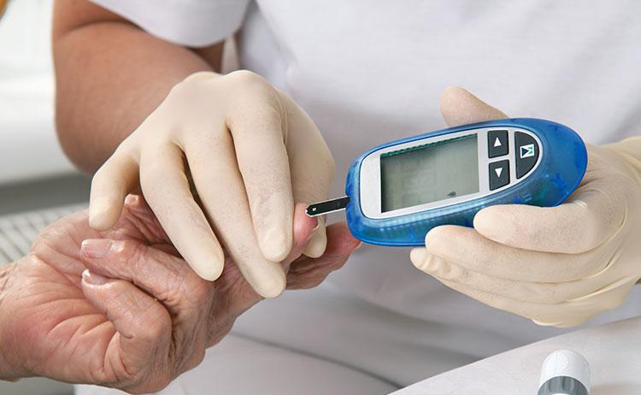
Diabetes
Global epidemic
7th leading cause of death
by 2030
Crucial to take proactive measures
In preventing this chronic illness

Slide 5
Our Objective
To develop and determine the best machine learning model that accurately predicts the likelihood of an individual developing diabetes based on various input factors such as glucose and BMI

Slide 6
02
Data Collection

Slide 7
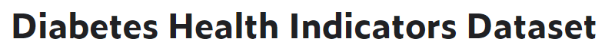
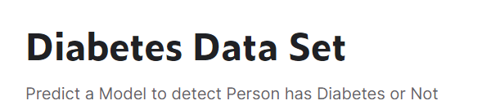
Data Collection
Big Dataset comprising of two sub datasets
Total of ~320, 000 Data Points
Mostly categorical data
21 predictor variables and 1 response variable
Small Dataset
2000 Data Points
Mostly numerical data
8 predictor variables and 1 response variable

Slide 8
03
Data Preparation

Slide 9
Data Cleaning Process
Drop unnecessary variables
Drop duplicates & 0s
Impute null values
From Big Dataset
Examples of variables dropped: Fruits, Veggies, AnyHealthcare
Dropped duplicates from big & small data.
Filtered data points with 0s for variables that possibly cannot be zero and dropped those rows.
700 sampled points from big data.
300 sampled points from small data.
KNN Imputer
Notes:
In our data cleaning process, firstly, we decided to drop variables that are not relevant to our project from big data and kept all the variables from the small data. After that, we dropped duplicates from the concatenated big data and small data. Apart from duplicates, we examined data points with 0s in certain numerical variables which possibly cannot be 0 for any patient. Then, 1000 data points were sampled altogether from concatenated big data and small data. 700 sampled points from big data whereas 300 sampled points from small data were appended together as joint data.
Because of multiple datasets being merged, there were alot of null values. We used KNN imputer to impute the values for all the null values.

Slide 10
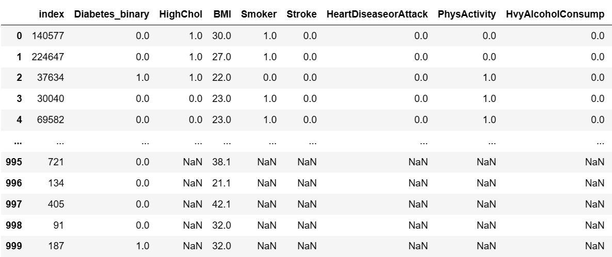
Before Imputation

Slide 11
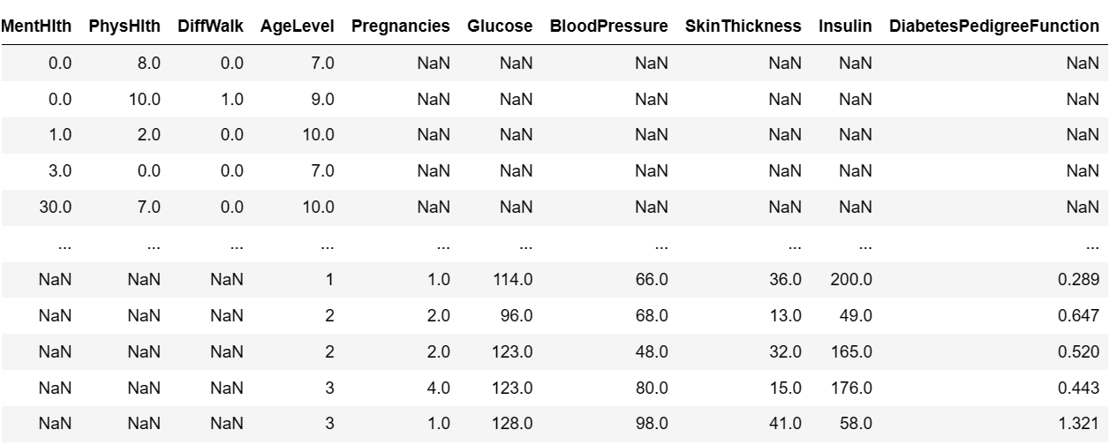
Before Imputation

Slide 12
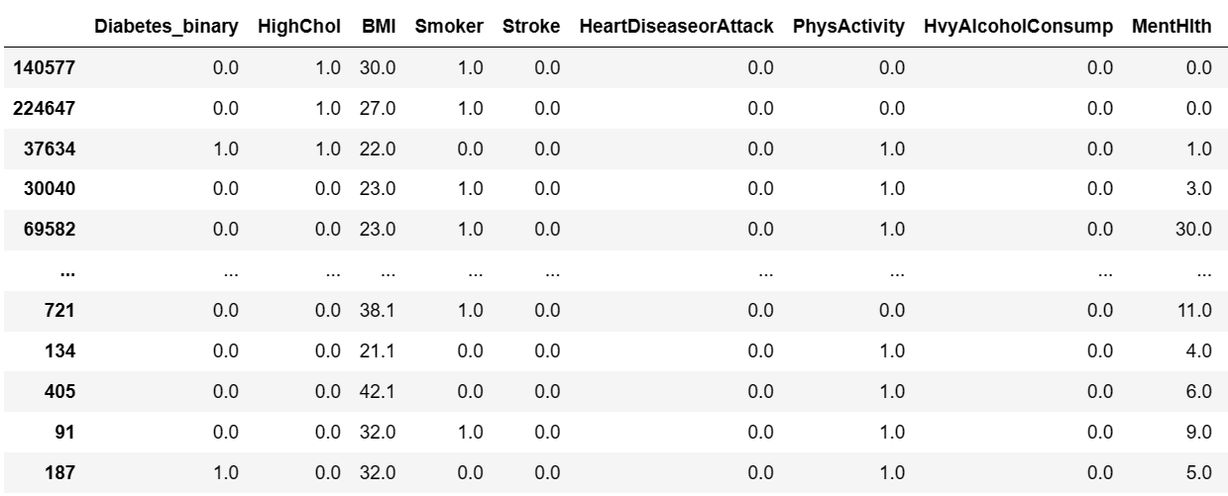
After Imputation
Notes:
After cleaning, these are our finalised variables. As mentioned earlier, we used KNN imputer to impute the null values. KNN stands for K-Nearest Neighbors, KNN imputer is used to impute missing values by finding the K nearest neighbors of a data point with missing values and replacing the missing values with the mean or median value of the K nearest neighbors.
The basic idea behind KNN imputation is to find the closest data points to a data point with missing values, based on the other available features in the dataset. The imputed value for a missing data point is then calculated based on the average or median of the values of its K nearest neighbors.
KNN imputation is a simple and effective imputation method that can be used in many different types of datasets, but it can be computationally expensive for large datasets. Additionally, KNN imputation assumes that the missing values are missing at random (MAR), which means that the probability of a value being missing is not related to the missing value itself, but only to other available features in the dataset.

Slide 13
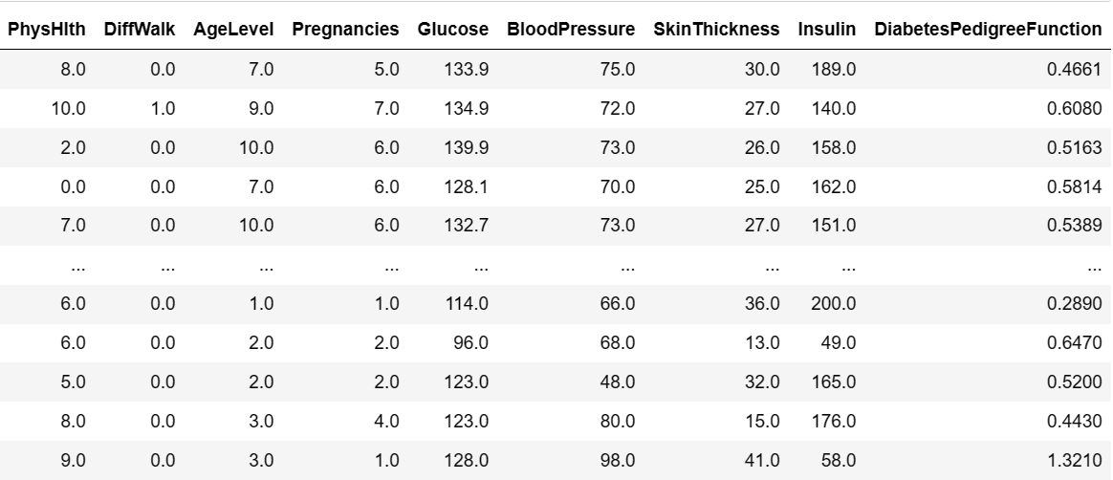
After Imputation

Slide 14
04
Exploratory Data Analysis

Slide 15
Uni-Variate
Data Exploration

Slide 16
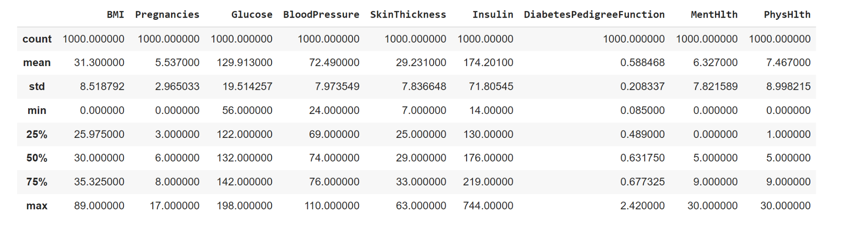
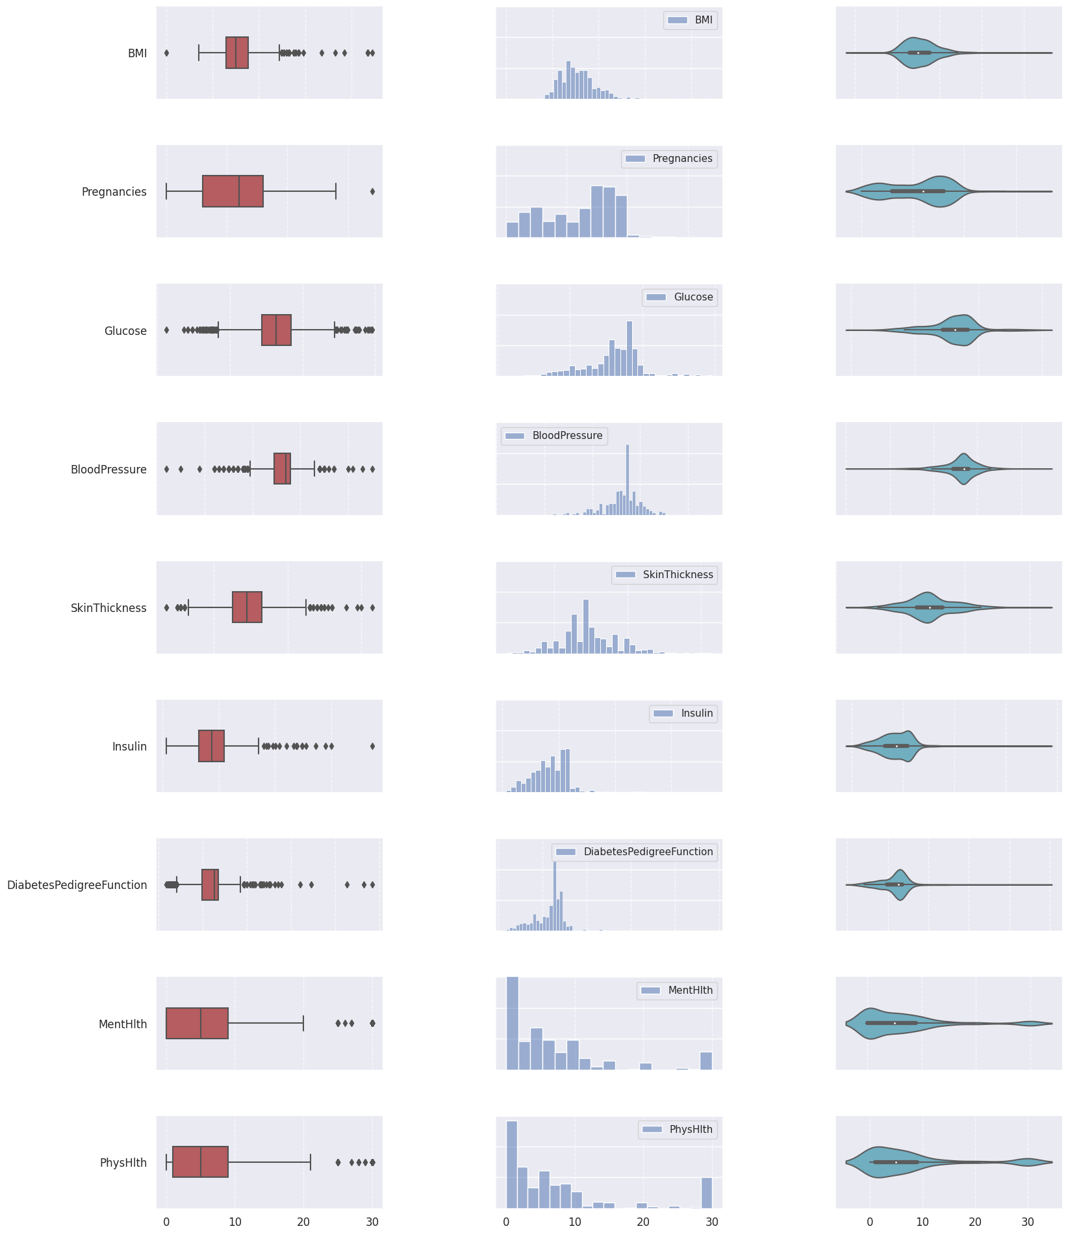
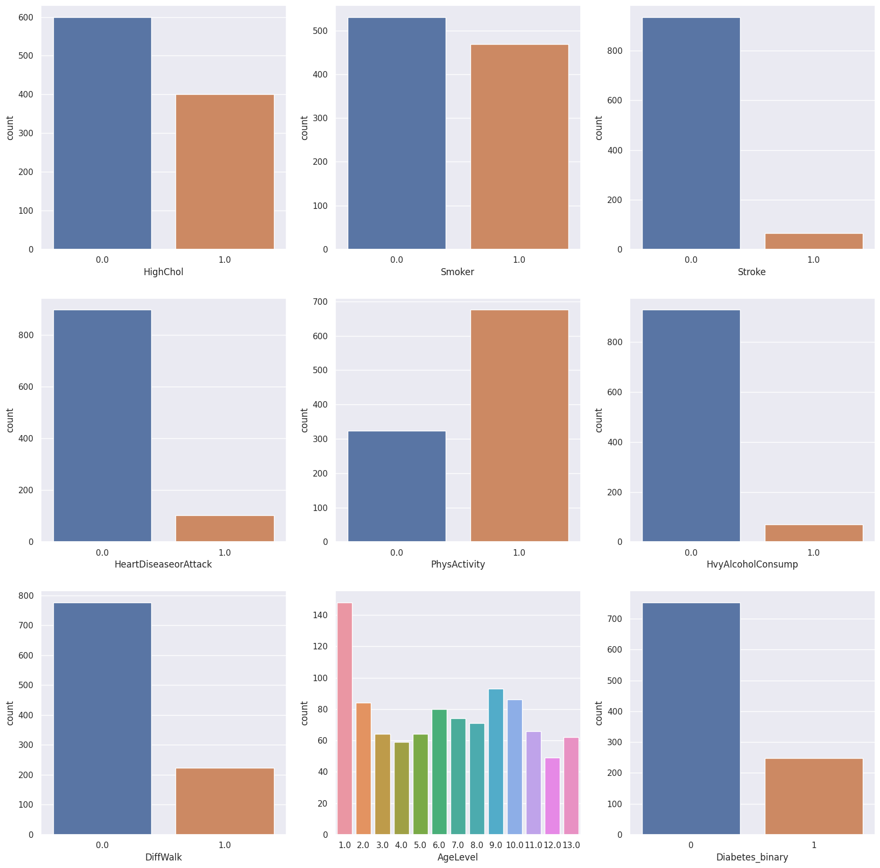
Summary statistics for numerical variables
Visualisations for numerical variables
Countplots for categorical variables

Slide 17
Bi-Variate
Data Exploration

Slide 18
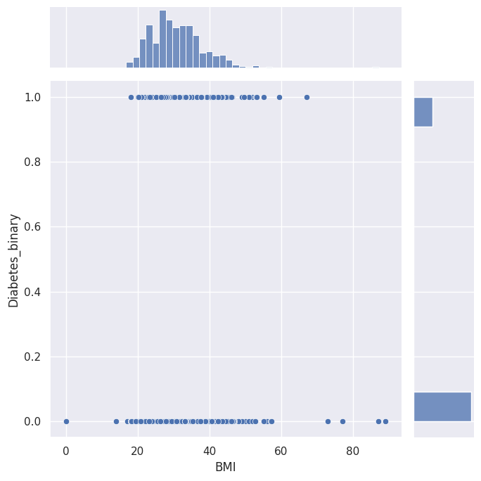
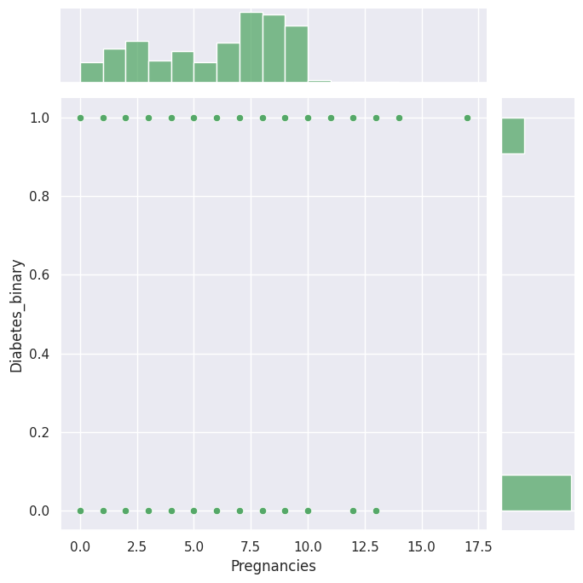
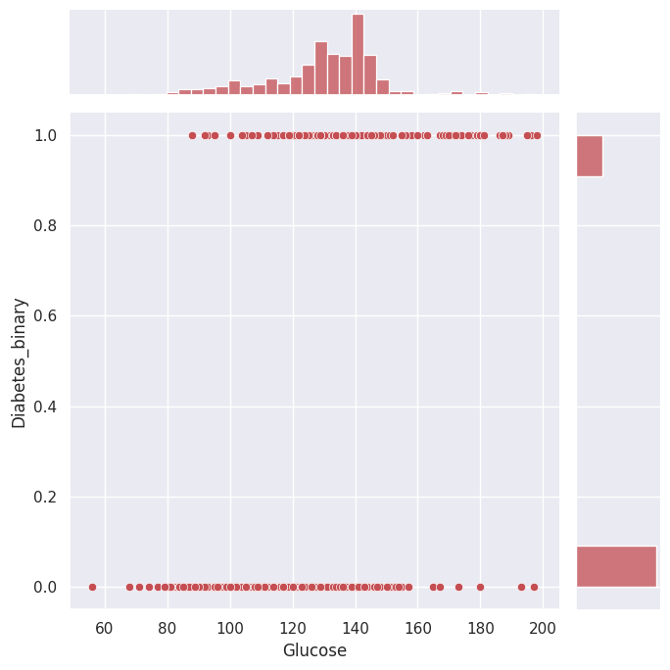
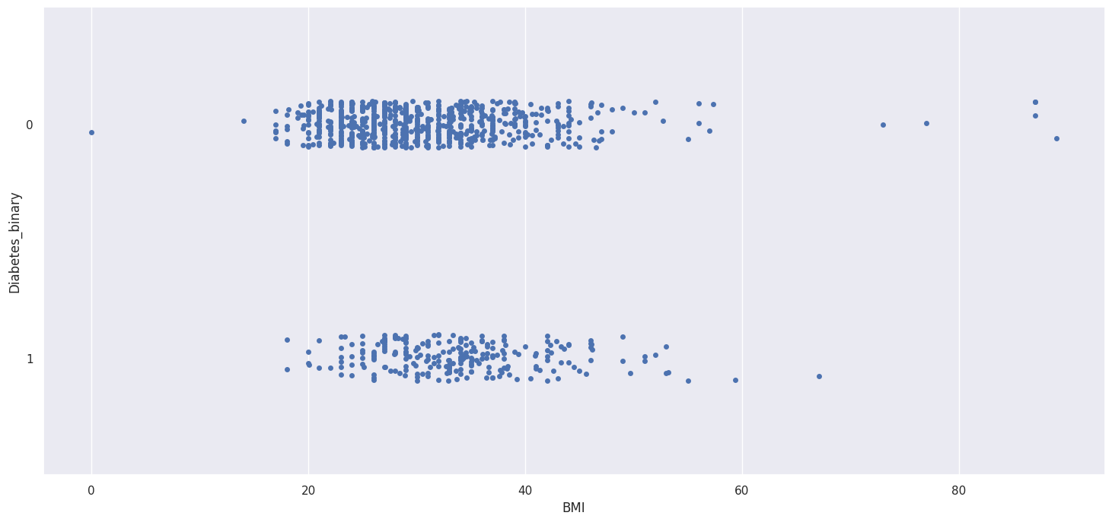
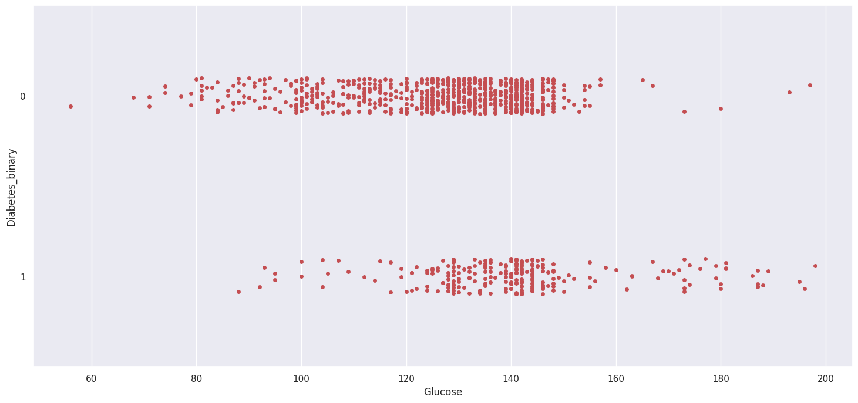
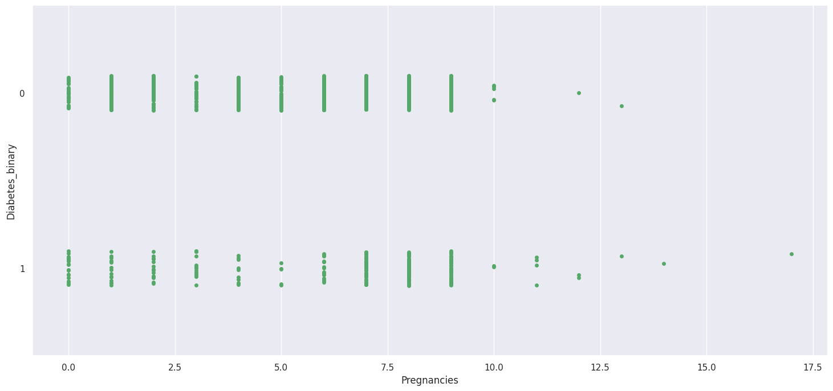
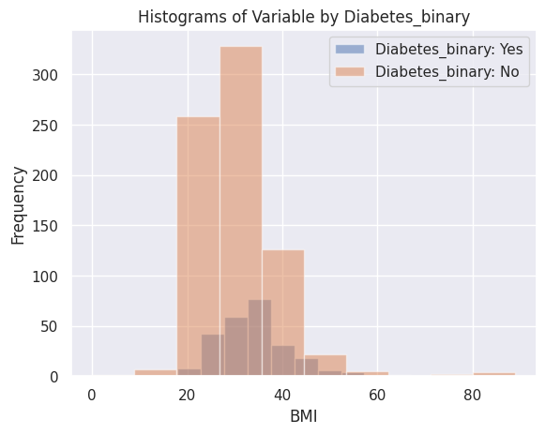
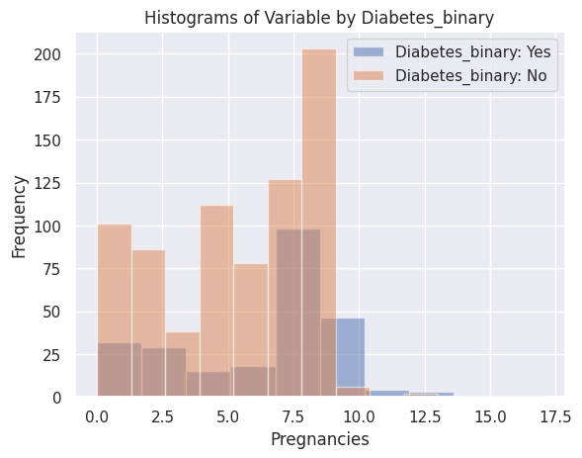
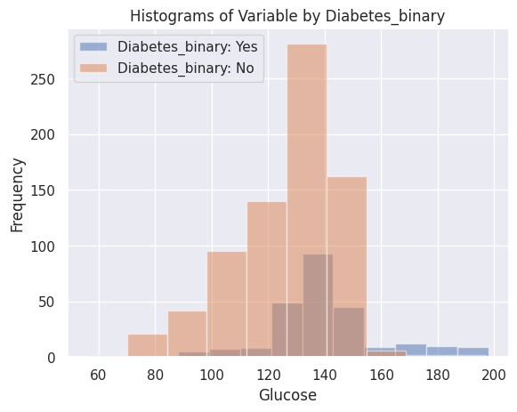
Joint plot
Swarm plot
Histogram

Slide 19
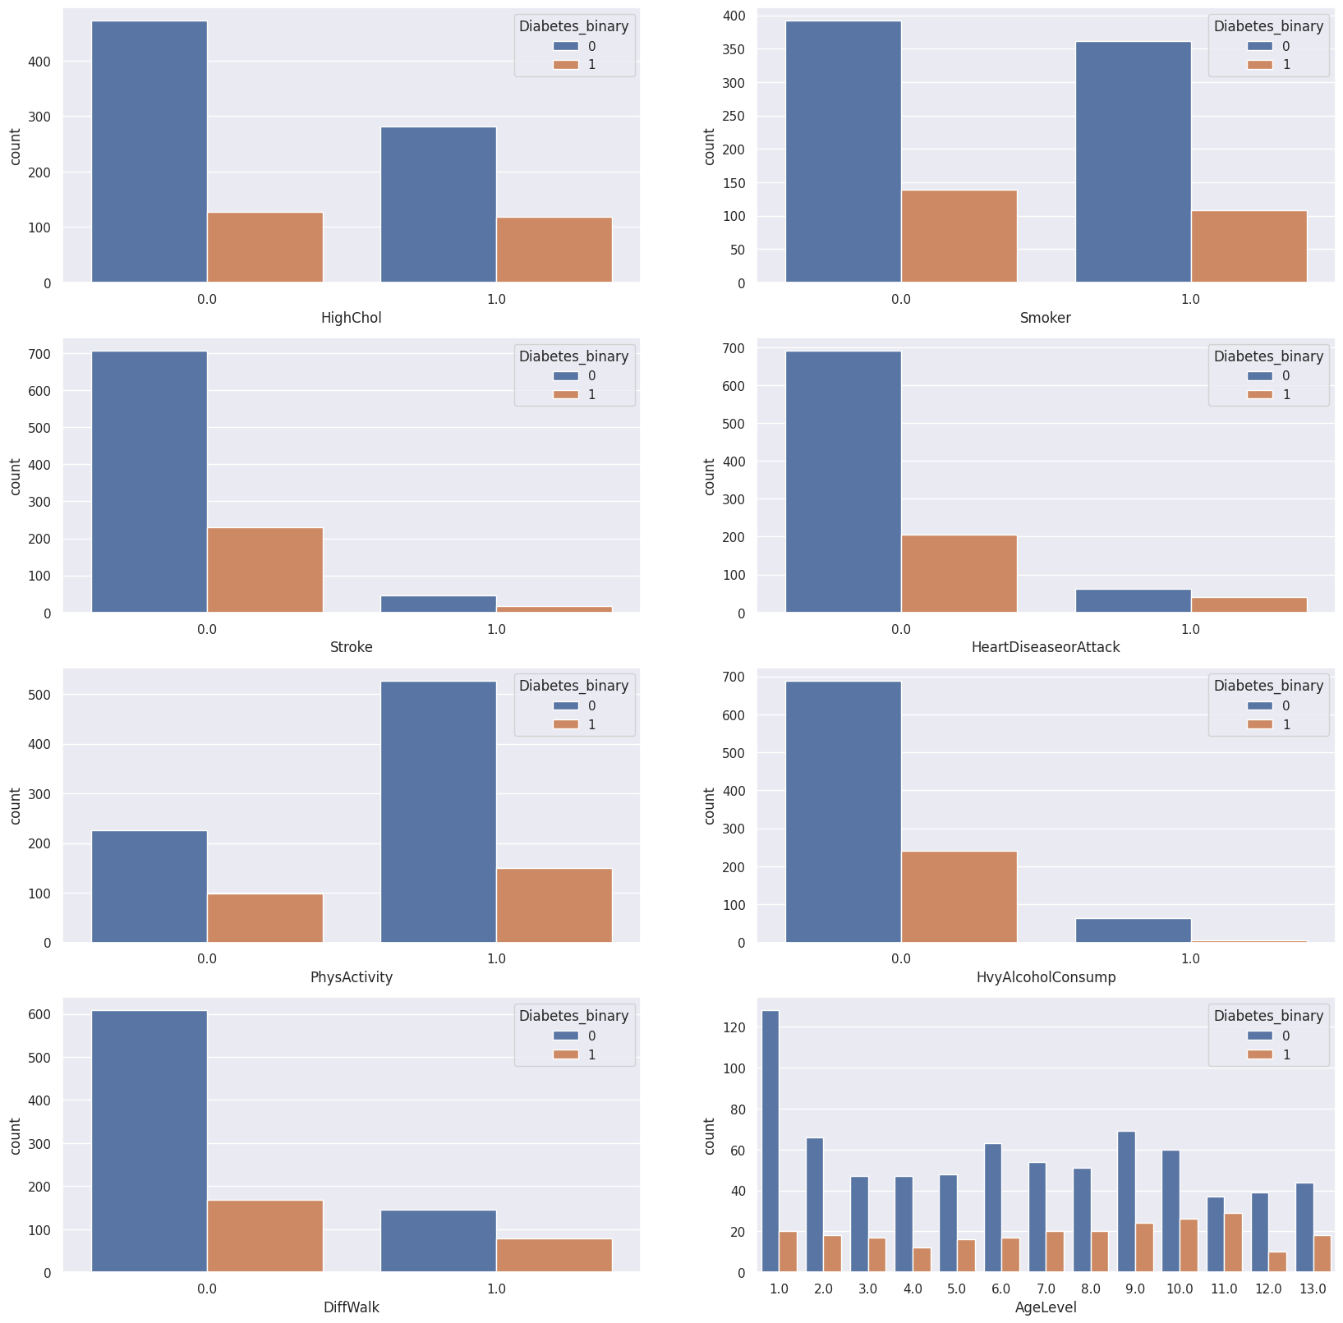
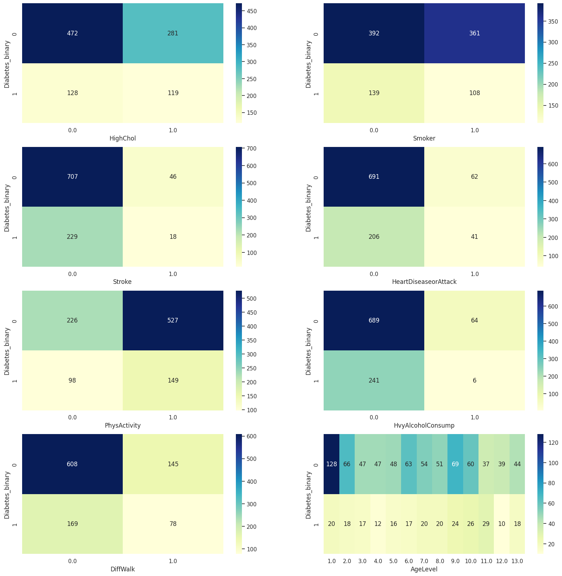
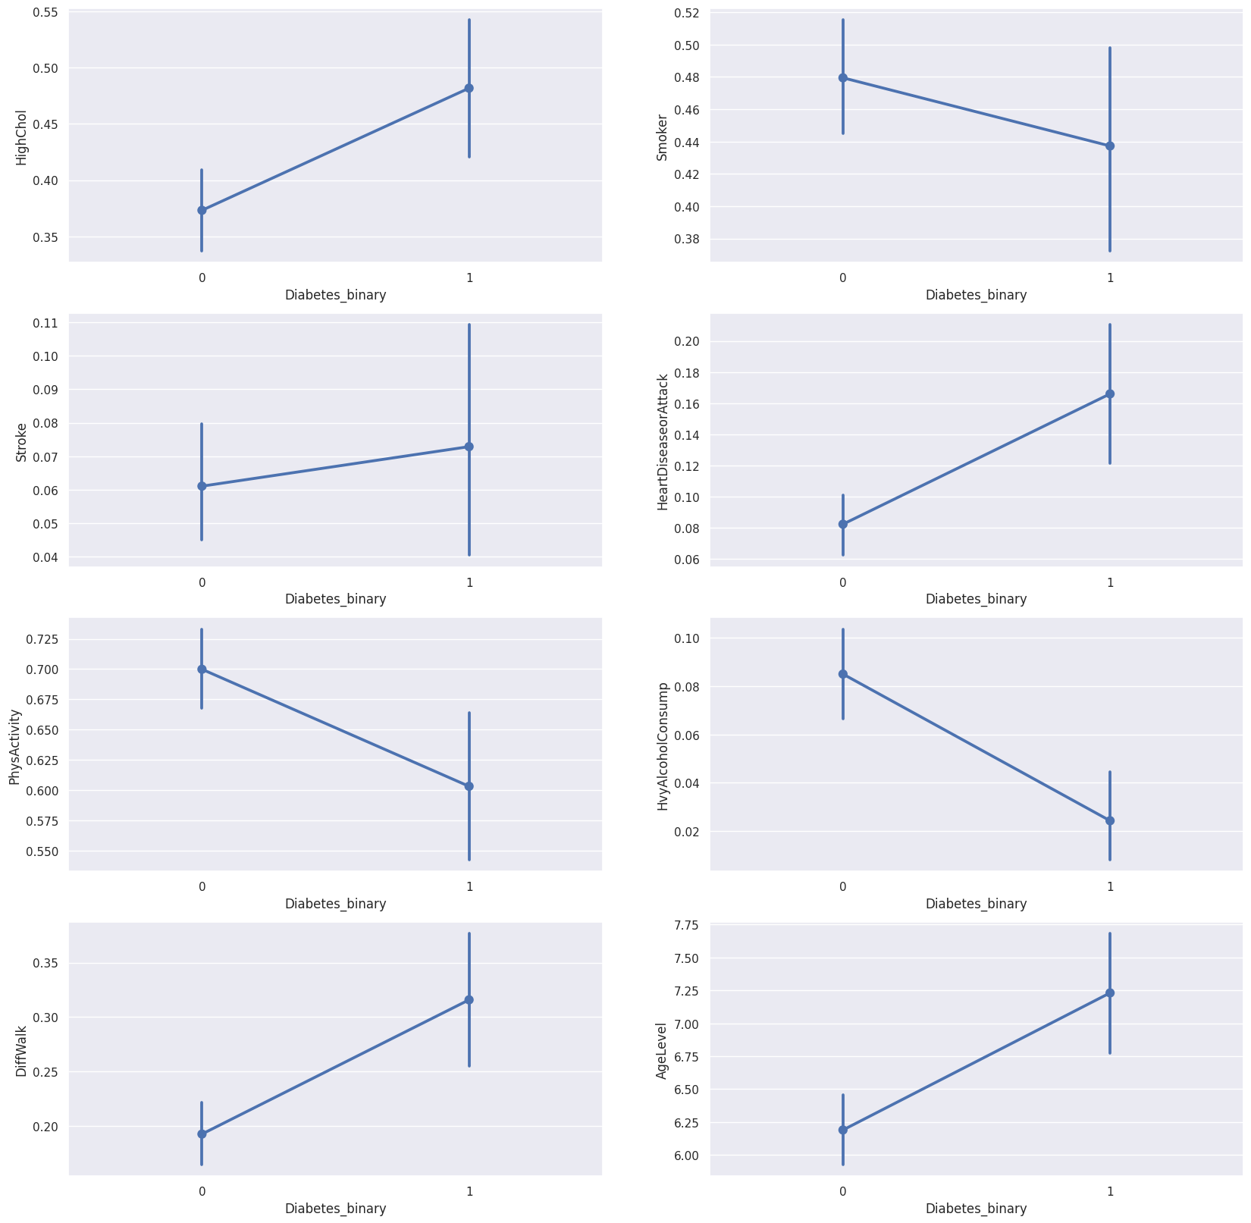
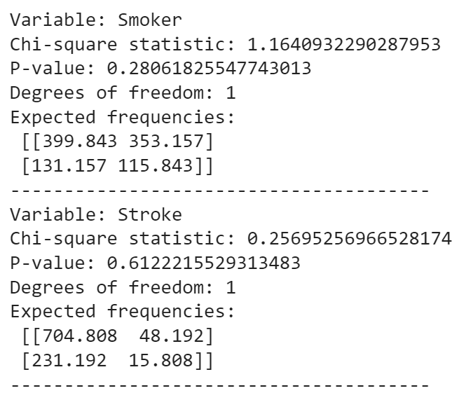
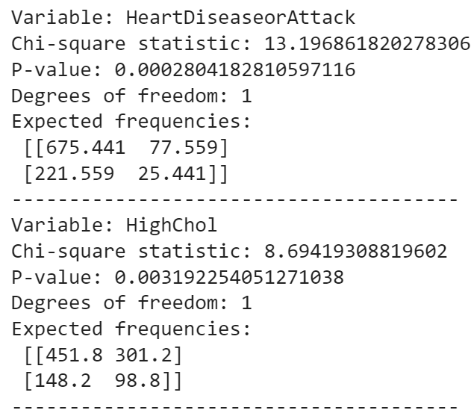
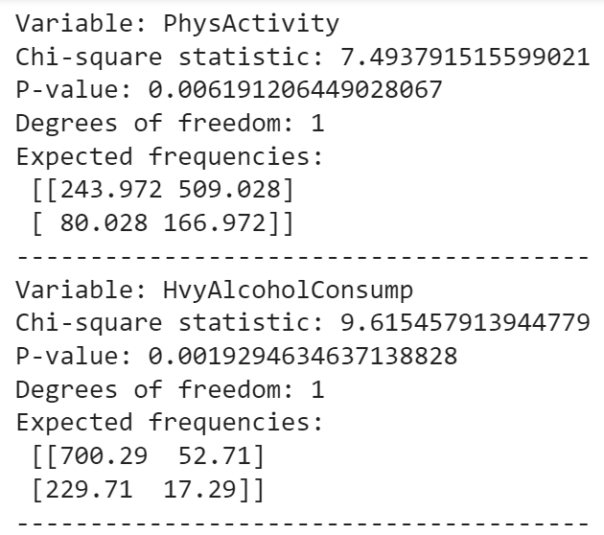
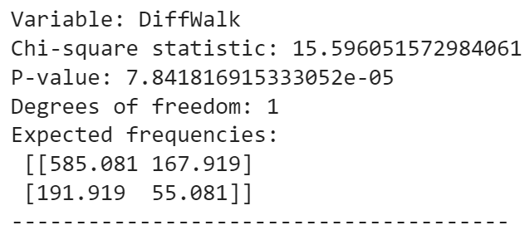
Countplots
Heatmap
Pointplot
Chi-square test

Slide 20
Multi-Variate
Data Exploration

Slide 21
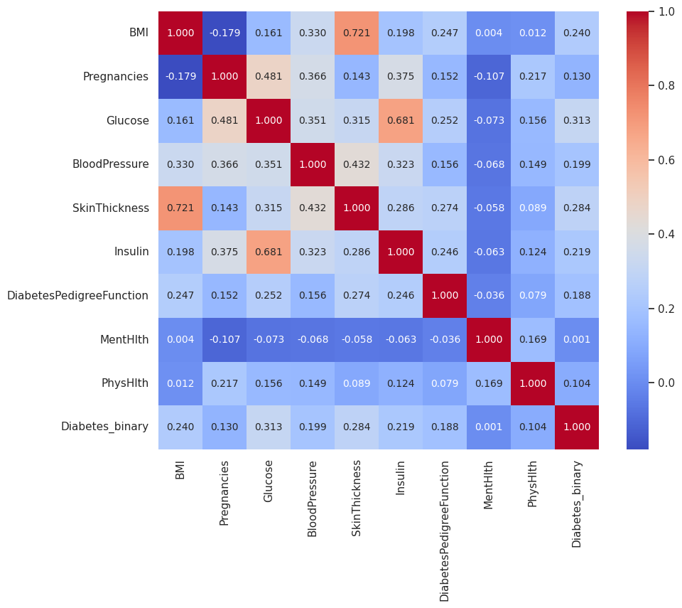
Correlation heatmap for numeric variables

Slide 22
Analysis of EDA

Slide 23
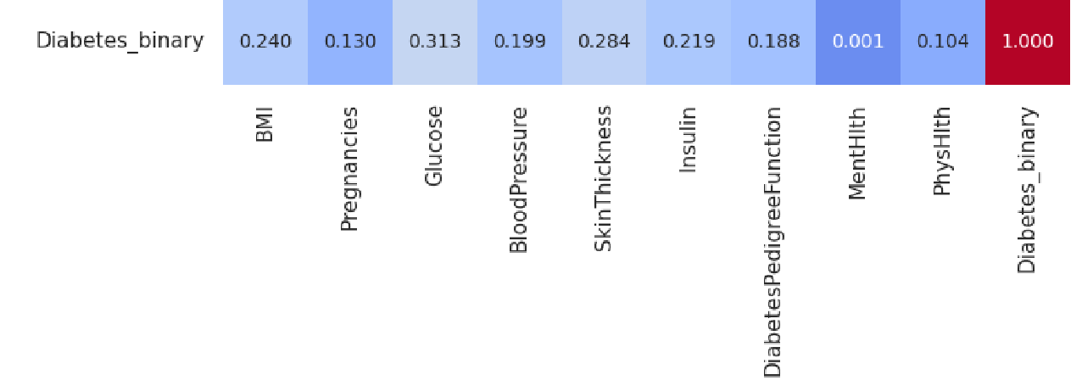
Feature variables chosen for machine learning
Numerical Variables
Glucose
BMI
SkinThickness
Highest correlation with diabetes_binary

Slide 24
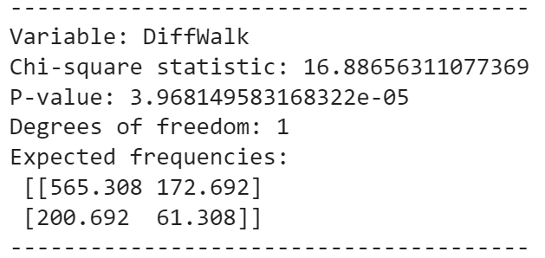
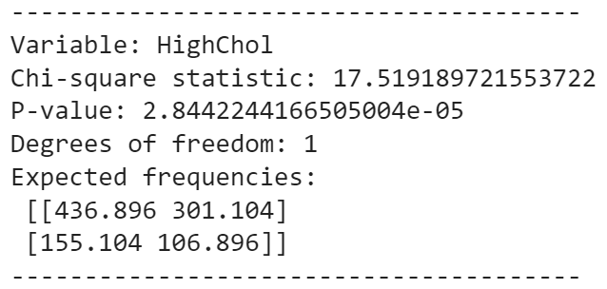
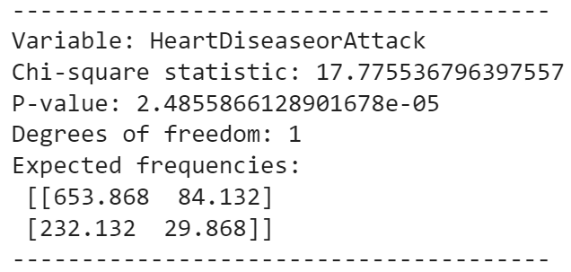
Feature variables chosen for machine learning
Categorical Variables (Binary)
DiffWalk
HeartDiseaseorAttack
HighChol
(Difficulty walking or climbing stairs)
(High Cholesterol)
Highest chi-square statistic and lowest p-value with diabetes_binary

Slide 25
05
Machine Learning

Slide 26
Model Selection

Slide 27
Logistic Regression
Random Forest
Support Vector Machine
All three models can handle both categorical binary predictor variables (DiffWalk, HeartDiseaseorAttack, HighChol) and numerical predictor variables (BMI, Glucose, SkinThickness). They can also handle the binary response variable (Diabetes_binary).

Slide 28
Model Training

Slide 29
Logistic Regression
Logistic regression is a statistical method used for binary classification
It estimates the probability of an event using a logistic function
An optimization algorithm is used to fit the model parameters
It can predict the probability of having diabetes based on predictor variables
Notes:
Numerical & binary variables

Slide 30
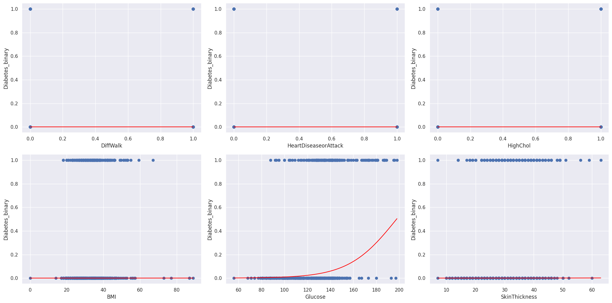
Logistic Regression
Response variable: 'Diabetes_binary' with 1 indicating presence and 0 indicating absence
Predictor variables:
'Diff Walk', 'HeartDiseaseorAttack', 'HighChol', 'BMI', 'Glucose', and 'SkinThickness'
Notes:
Numerical & binary variables

Slide 31
Random Forest
Random Forest is an ensemble machine learning algorithm that combines multiple decision trees to create a powerful predictive model
It uses subsets of data and features to create decision trees
The algorithm aggregates the predictions for the final outcome
Suitable for classification and regression tasks
Notes:
Random Forest is a tree-based machine learning algorithm that belongs to the family of ensemble methods. It combines multiple decision trees to create a powerful predictive model. In a random forest, multiple decision trees are created using subsets of the original data and a random subset of features. The algorithm then aggregates the predictions from each decision tree to arrive at a final prediction. Random Forest can be used for both classification and regression tasks. It handles both categorical and numerical variables.

Slide 32
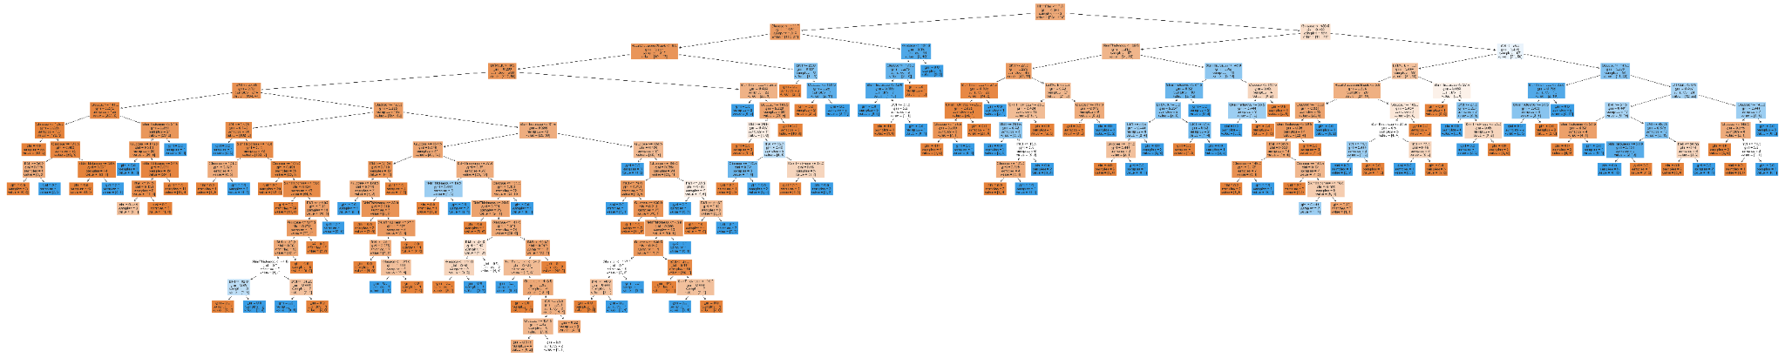
Random forest Classification
Numerical
Splits the data into intervals
Creates decision trees based on the intervals
Variables
Categorical
(Binary)
0.5 is used as the threshold for deciding whether a sample belongs to one class or another.
Notes:
The image shows the random forest tree generated for predictor variables of numerical and binary variables. The image can be viewed detaily in code. The model random forest classifier splits the data into intervals and creates decision trees based on the intervals for numerical variables. Whereas for binary variables 0.5 is used as the threshold for deciding whether a sample belongs to one class or another.

Slide 33
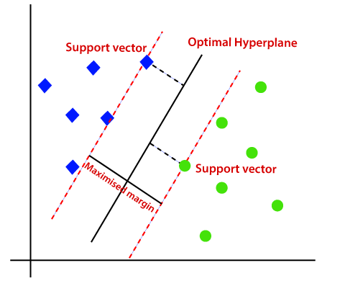
Support Vector Machine (SVM)
SVM is an algorithm that finds a hyperplane that best separates the data points of different classes and has the maximum margin

Slide 34
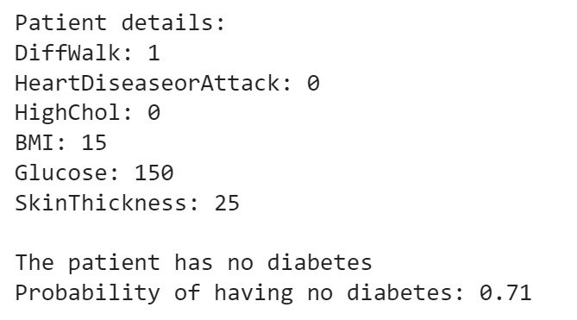
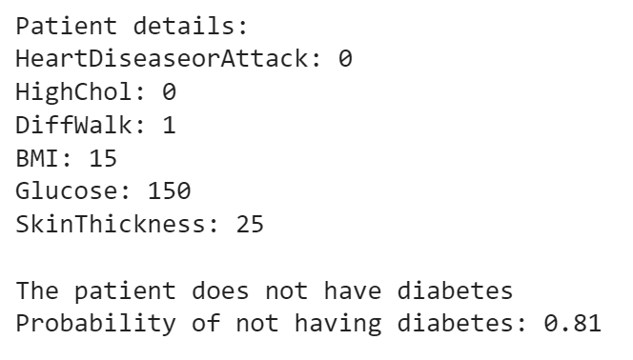
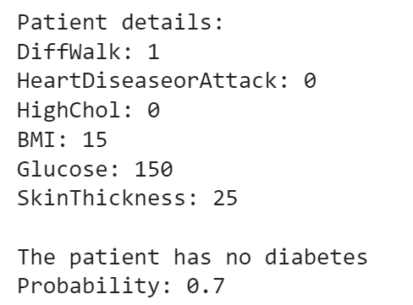
Prediction using our models
Logistic Regression Model
Random Forest
SVM Model
Consistent and similar prediction results
Notes:
In the end, random data was used to test all the models and all our models have shown exactly similar results.

Slide 35
Model Evaluation

Slide 36
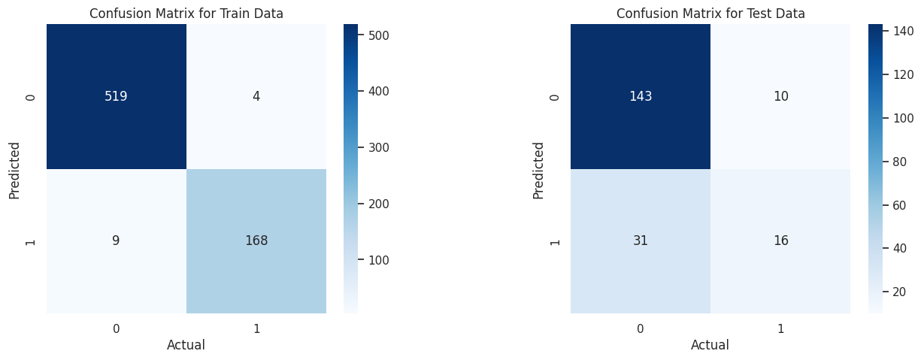
Logistic Regression
TPR = 0.949
FPR = 0.008
TNR = 0.992
FNR = 0.051
-> Accuracy of 98.8%
TPR = 0.340
FPR = 0.065
TNR = 0.935
FNR = 0.660
-> Accuracy of 79.5%

Slide 37
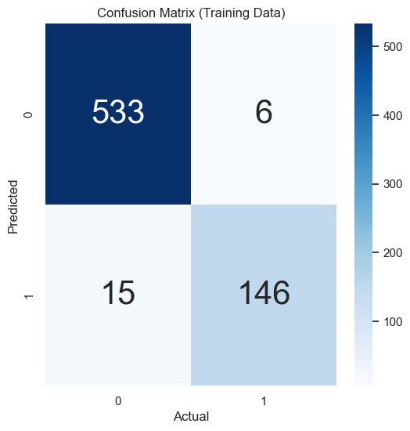
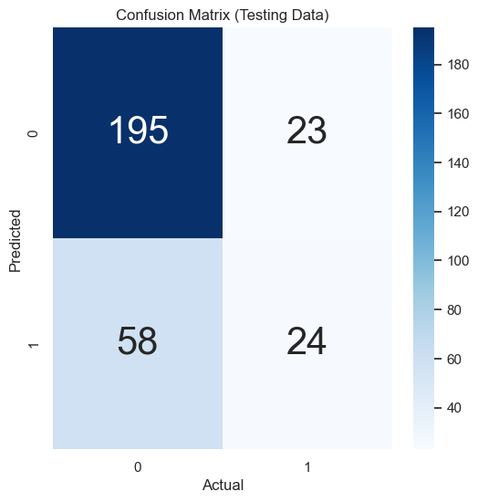
Random forest classification
TPR: 0.907
FPR: 0.011
TNR: 0.011
FNR: 0.093
-> Accuracy: 97.0%
TPR: 0.400
FPR: 0.114
TNR: 0.886
FNR: 0.600
->Accuracy: 74.0%
Notes:
To evaluate training data, random forest classification model correctly identifies 90.7% of the positive samples which can be evidently seen from the TPR value.
One of the most important indication in this project FNR which is actual positive samples that are incorrectly classified as negative records 9.3%.
Overall, the accuracy of the model on the training data is 97.0%, which is the proportion of correct predictions to the total number of predictions. The accuracy indicates that the model performs well on the training data.
Moving on to test data, test data computes 60% of positive samples as negative and an accuracy of 74.0% which is the proportion of correct predictions to the total number of predictions. The accuracy is significantly lower than the accuracy on the training data, which indicates that the model may be overfitting to the training data and not generalizing well to new data.
Apart from this, classification report is also generated for both train and test data which can ce be viewed in the code.

Slide 38
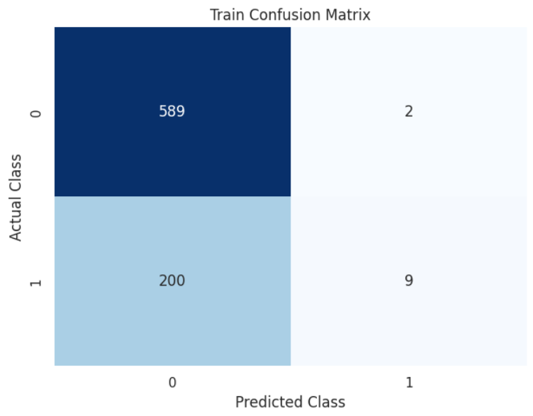
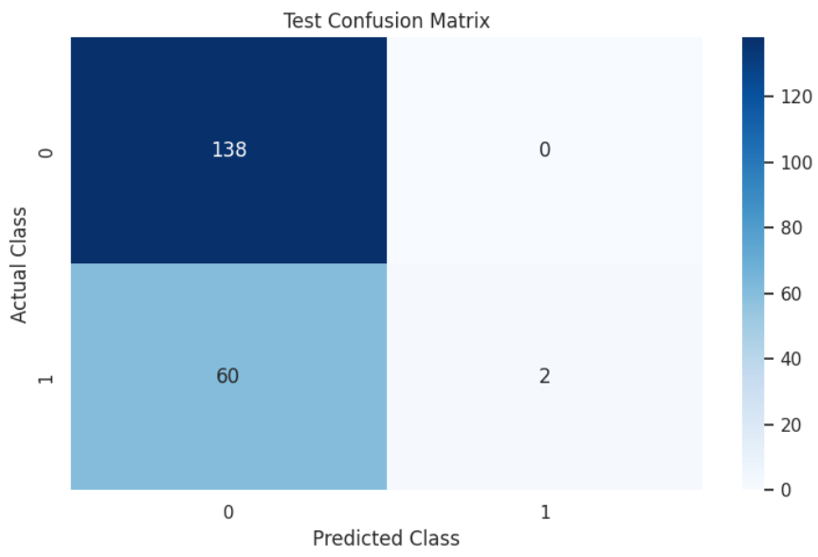
Support Vector Machine
TPR = 0.043
FPR = 0.003
TNR = 0.997
FNR = 0.957
-> Accuracy of 74.8%
TPR = 0.032
FPR = 0
TNR = 1
FNR = 0.968
-> Accuracy of 70.0%

Slide 39
Comparing across all three machine learning models
Logistic Regression Model shows the best prediction for diabetes
Accuracy Scores
False Negative Rate (FNR)
Logistic Regression model has the highest accuracy score for train and test data
Logistic Regression model generally has the lower FNR for train and test data
Notes:
Comparing across all three machine learning models on accuracy scores and False Negative Rate (FNR), we concluded that logistic regression model shows the best prediction for diabetes.
Accuracy and False Negative rate (FNR) are important in diabetes prediction system. This is because,
Accuracy Accuracy score indicates the proportion of correctly predicted cases (both true positives and true negatives) out of all the cases evaluated by the system. A high accuracy score means that the prediction system is correctly identifying the majority of cases, both those with and without diabetes.
False Negative rate indicates how many individuals with diabetes are being missed by the prediction system. In the context of diabetes prediction, a false negative result means that an individual who has diabetes is incorrectly classified as not having the disease. This can have serious consequences, as the individual may not receive the necessary treatment and management for their condition.

Slide 40
Improving the performance of chosen model
Tuning process
Feature selection
Ensembling
Regularisation
Data augmentation

Slide 41
06
Conclusion

Slide 42
Conclusion
Develop a machine learning model that accurately discerns the possibility of a person developing diabetes
Explored new ways of visualising and predicting our data
Point plot
Histograms of the numeric variable separately for each level of the binary variable
Chi square statistic for categorical variable
Logistic Regression
Random Forest Classification
Support Vector Machine Algorithm
Necessity for Model Evaluation

Slide 43
References
https://www.einsteinmed.edu/centers/global-health/global-diabetes-institute/about-us/global-diabetes/index.html (7th leading cause of death in 2030)
https://www.moh.gov.sg/news-highlights/details/speech-by-mr-ong-ye-kung-minister-for-health-at-world-diabetes-day-2021#:~:text=Locally%2C%20one%20in%20three%20individuals,will%20be%20living%20with%20diabetes. (Locally in sg, one in three people get diabetes)
https://vizhub.healthdata.org/gbd-compare/#0 (Graph of global diabetes )
https://www.narayanahealth.org/blog/diabetes-mellitus-guide/ (Picture of person taking glucose level)

